Slide 1
Big-Data Analytics with Azure HDInsight
Microsoft Research

Slide 2
Big Data
Device Explosion
Social Networks
Cheap Storage
$100 gets you 3 million times more storage in 30 years
>5.5 billion (70+% of global population)
>2 Billion
users
Ubiquitous Connection
Sensor Networks
Inexpensive Computing
Web traffic
2010 130 Exabyte (10 E18)
2015 1.6 ZettaByte (10 E21)
>10 Billion
1980 10 MIPS/$
2005 10M MIPS/$

Slide 3

Azure HDInsight
Microsoft Azure’s big-data solution using Hadoop
Open-source framework for storing and analyzing massive amounts of data on clusters built from commodity hardware
Uses Hadoop Distributed File System (HDFS) for storage
Employs the open-source Hortonworks Data Platform implementation of Hadoop
Includes Hive, Pig, Storm, Spark, and more
Integrates with popular BI tools
Includes Power BI, Excel, SSAS, SSRS, Tableau
Notes:
Apache Hive is a data warehouse infrastructure built on top of Hadoop for providing data summarization, query, and analysis. Initially developed by Facebook, Apache Hive is now used and developed by other companies such as Netflix. Amazon maintains a software fork of Apache Hive that is included in Amazon Elastic MapReduce on Amazon Web Services
NOTE: Removed “Linux and Windows because of Spark’s decision to remove Windows support. Probably worth de-emphasizing the OS and instead focusing on the HDI platforms offered.

Slide 4
Why Hadoop on Azure?
Automatic cluster provisioning & configuration
Bypass an otherwise manual-intensive process
Cluster scaling
Change number of nodes without deleting/re-creating the cluster
High availability/reliability
Managed solution - 99.9% SLA
HDInsight includes a secondary head node
Reliable and economical storage
HDFS mapped over Azure Blob Storage
Accessed through “wasb://” protocol prefix
Notes:
Source: https://azure.microsoft.com/en-us/documentation/articles/hdinsight-hadoop-introduction/ (Advantages of Hadoop in the Cloud)
What would it take for YOU to manage a 500-node cluster? How many resources, how much work in checking node health, etc?
Note about HDFS: Most HDFS commands work (except OS-specific ones like fschk)

Slide 5
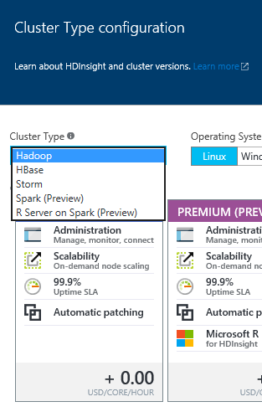
HDInsight Cluster Types
Hadoop: Query workloads
Reliable data storage, simple MapReduce
HBase: NoSQL workloads
Distributed database offering random access to large amounts of data
Apache Storm: Stream workloads
Real-time analysis of moving data streams
Apache Spark: High-performance workloads
In-memory parallel processing

Slide 6

Apache Spark
Interactive manipulation and visualization of data
Scala, Python, and R Interactive Shells
Jupyter Notebook with PySpark (Python) and Spark (Scala) kernels provide in-browser interaction
Unified platform for processing multiple workloads
Real-time processing, Machine Learning, Stream Analytics, Interactive Querying, Graphing
Leverages in-memory processing for really big data
Resilient distributed datasets (RDDs)
APIs for processing large datasets
Up to 100x faster than Hadoop
Notes:
Notes – the notions of interactivity and immediacy when working with Spark are key/fundamental
https://azure.microsoft.com/en-us/documentation/videos/announcing-apache-spark-on-azure-hdinsight/
Notes – not *just* fast for in-memory, but also fast for on-disk/larger data sets
Apache Spark is a fast, in-memory data processing engine with elegant and expressive development APIs in Scala, Java, Python, and R that allow data workers to efficiently execute machine learning algorithms that require fast iterative access to datasets. Spark on Apache Hadoop YARN enables deep integration with Hadoop and other YARN enabled workloads in the enterprise.
At the core of Spark is the notion of a Resilient Distributed Dataset (RDD), which is an immutable collection of objects that is partitioned and distributed across multiple physical nodes of a YARN cluster and that can be operated in parallel. Typically, RDDs are instantiated by loading data from a shared filesystem, HDFS, HBase, or any data source offering a Hadoop InputFormat on a YARN cluster.
Once an RDD is instantiated, you can apply a series of operations. All operations fall into one of two types: transformations or actions. Transformation operations, as the name suggests, create new datasets from an existing RDD and build out the processing Directed Acyclic Graph (DAG) that can then be applied on the partitioned dataset across the YARN cluster. An Action operation, on the other hand, executes DAG and returns a value.
Spark can perform up to 100 times faster than Hadoop thanks to its in-memory parallel processing model.

Slide 7
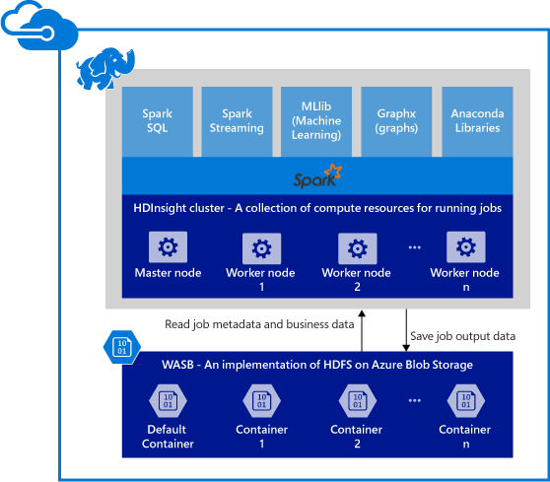
Spark Components on HDInsight
Spark Core
Includes Spark SQL, Spark Streaming, GraphX, and MLlib
Anaconda
Livy
Jupyter Notebooks
ODBC Driver for connecting from BI tools (Power BI, Tableau)

Slide 8
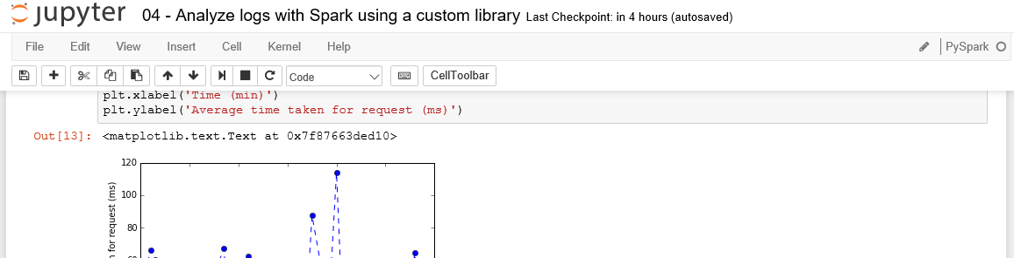
Jupyter Notebooks on HDInsight
Provide a browser-based interface for working with text, code, equations, plots, graphics, and interactive controls in a single document.
Include preset Spark & Hive contexts (sc & sqlContext, respectively)

Slide 9
Items of Note About HDInsight
There is no “suspend” on HDInsight clusters
Provision the cluster, do work, then delete the cluster to avoid unnecessary charges
Storage can be decoupled from the cluster and reused across deployments
Can deploy from the portal, but often scripted in practice
Easier/repeatable creation and deletion

Slide 10
Hands-On Lab
Apache Spark for Azure HDInsight
HDInsight Spark HOL.html

